Slide 1
The Spirit of Mankind: Selflessness
Kayla Meester
Ireen Schloissnik
Nike Younkins

Slide 2
Definition: Selflessness
Having, exhibiting, or motivated by no concern for oneself; unselfish
Renunciation of your own interests in favor of the interests of others
Altruism
Notes:
Each group member will give their own definition as well and a personal connection to the word

Slide 3
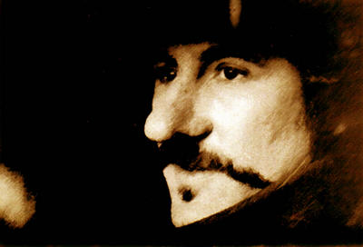
Literary Connection: Cyrano de Bergerac
“My life's work has been to prompt others and be forgotten. Remember that night when Christian came to your balcony? That moment sums up my life. While I was below in the shadows, others climbed up to kiss the sweet rose” (Rostand 312).
Notes:
-Cyrano is in love with Roxane but she is in love with Christian so he helps to bring the two together because it is what she wants.
-Just before Christian dies, Cyrano lies and tells him that Roxane has learned of the forged letters, but has still chosen Christian. Cyrano decides he can never tell Roxane the truth.

Slide 4
Cyrano de Bergerac

Slide 5
Cyrano de Bergerac
Refunds tickets
Saves Ligniere
Writes for Christian
Visits Roxane
Notes:
-Fights 100 men alone to save Ligniere. He receives no material reward. He put himself in danger to save a friend.
-Refunds the entire audience’s tickets for the play that he has deemed a disgrace to the arts.

Slide 6
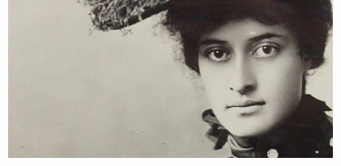
Princess Ka’iulani
Born October 16th, 1875 in Honolulu to Miriam Likelike and Archibald Cleghorn
Uncle was King of Hawaii
Sent to Northamptonshire, England when she was only 13 to be educated
Uncle died and her Aunt took the throne
Notes:
Sent to Northampshire, England when she was only 13 to be educated
-She was mistreated by her peers who believed her to be barbaric due to her ethnicity. Contrary to their beliefs, Ka’iulani could speak English, French and German all fluently in addition to her native tongue.
-Her Aunt was soon overthrown by American businessmen. Hawaii was in distress over the fear of annexation.

Slide 7
Princess Ka’iulani Speech
"Four years ago, at the request of Mr. Thurston, then a Hawaiian Cabinet Minister, I was sent away to England to be educated privately and fitted to the position which by the constitution of Hawaii I was to inherit. For all these years, I have patiently and in exile striven to fit myself for my return this year to my native country. I am now told that Mr. Thurston will be in Washington asking you to take away my flag and my throne. No one tells me even this officially. Have I done anything wrong that this wrong should be done to me and my people? I am coming to Washington to plead for my throne, my nation and my flag. Will not the great American people hear me?“ (Fahrni 3)
Notes:
-She said this quote to the press in England after she had heard that her aunt had been overthrown.
-She left England for America.

Slide 8
Princess Ka’iulani
The American press had been slandering the Hawaiian people, painting them as barbaric illiterates
http://www.youtube.com/watch?v=bIfVHmy3Zd8
Met with President Cleveland and his wife
Notes:
-They were shocked at the site of the beautiful and eloquent Princess.
-They took a liking to her immediately and the President promised to do everything he could to prevent the annexation under his term.
-Still, the Hawaiian monarchy was never restored.

Slide 9
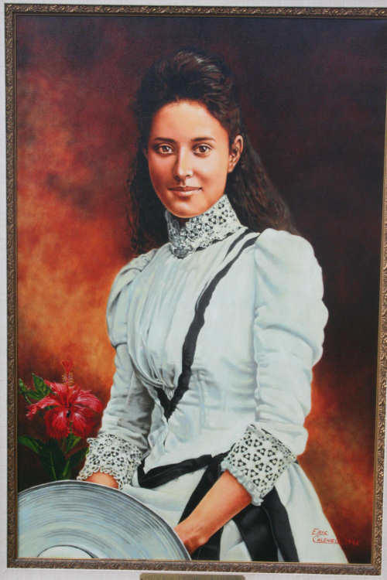
Princess Ka’iulani
She was able to win the right to vote for her people
Hawaii became a republic under President McKinley
Notes:
-She died at the young age of 23 in 1898. To this day, people claim it was due to a broken heart at the loss of her country.

Slide 10
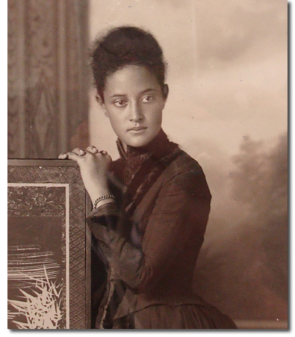
Princess Ka’iulani
http://www.youtube.com/watch?v=YnG1cQja_JA

Slide 11
Her Legacy
Saving Hawaii from annexation
Her critical decisions include leaving Hawaii and the people who loved her
Embodies the selfless spirit because of the true devotion she showed her country and her people

Slide 12
Selflessness Today
Charities
Volunteering
Donating Blood
http://www.youtube.com/watch?v=6S1M1NxfjvY
Random Acts of Kindness
Notes:
-There are many charities around the world that do good for others and expect nothing in return. Some of these organizations include Compassion International, a child sponsorship program; the American Red Cross and the Salvation Army; and Freedom from Hunger.
-Selflessness doesn’t have to involve donating money or items, it can just be a small kind gesture or a helping hand.

Slide 13
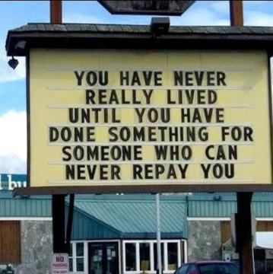
Modern Examples

Slide 14
Selflessness in the news:

Slide 15
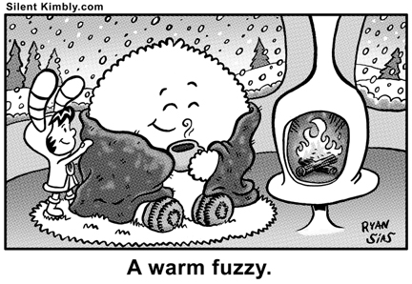
Class Activity: Warm Fuzzies
Write a Warm Fuzzy for the person whose name is at the top of the paper.
You can choose to sign your name or remain anonymous.
Fold your paper and pass them up.
Notes:
-Warm Fuzzies are warming messages of friendliness to someone, by remaining anonymous you are giving selflessly to another without expecting anything in return.

Slide 16
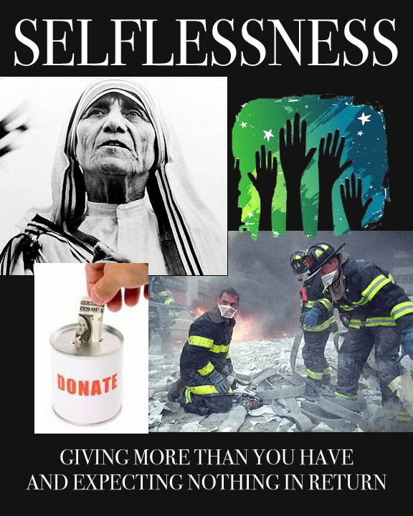
Advertisement

