Slide 1


OnRamps Credit Period
Step-by-Step Instructions
2016-2017

Slide 2
Credit Period Timeline
Activity | Date
UT Austin Instructor of Record determines Final College Grade | May 12, 2017
Credit Period Opens Students may view Final College Grade & Default Credit Status Students may change Default Credit Status if desired | May 15, 2017 8AM
Credit Period Closes Students may not make any further changes to Credit Status | May 18, 2017 5PM
OnRamps reports only enrollments with credit status Credit Earned, Accepted to Registrar | May 19, 2017

Slide 3
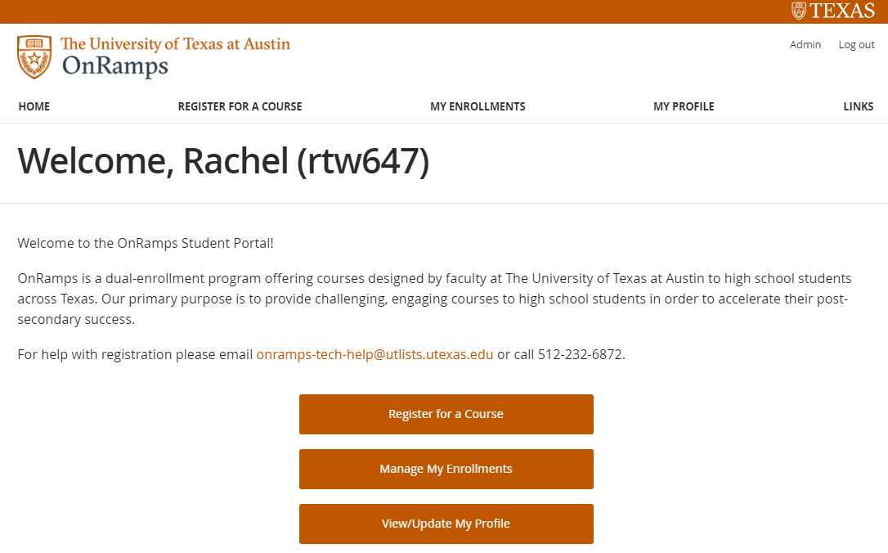
Step-by-Step Instructions
Students log in to OnRamps Student Portal using their UT EID and password: https://utdirect.utexas.edu/apps/ce/osis/
Students click Manage My Enrollments button to access the Current Enrollments table.

Slide 4
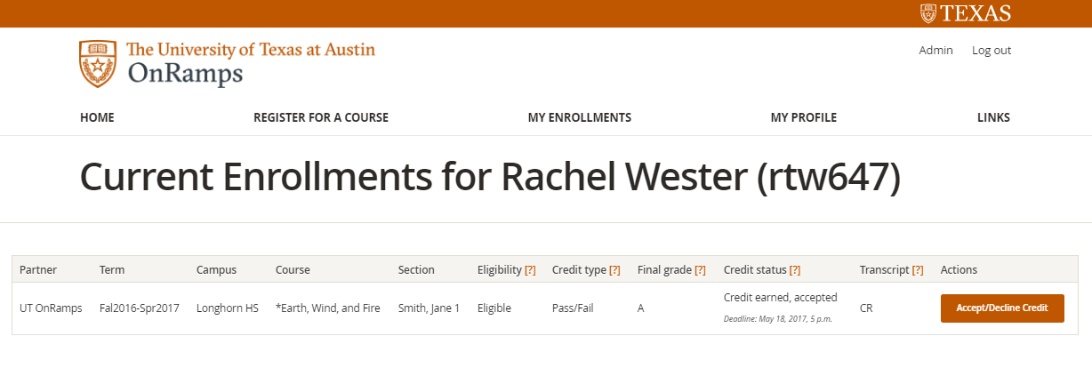
Step-by-Step Instructions
Students view Final Grade and Default Credit Status in the Current Enrollments table. The Default Credit Status is automatically assigned based on the student’s Final Grade and Credit Type.
Students also view the Transcript grade or code that will appear on the UT Austin transcript, given their Credit Type and Default Credit Status.

Slide 5
Step-by-Step Instructions
If students are satisfied with their Default Credit Status, no action is required.
If students wish to change their Default Credit Status, they click the Accept/Decline Credit button.

Slide 6
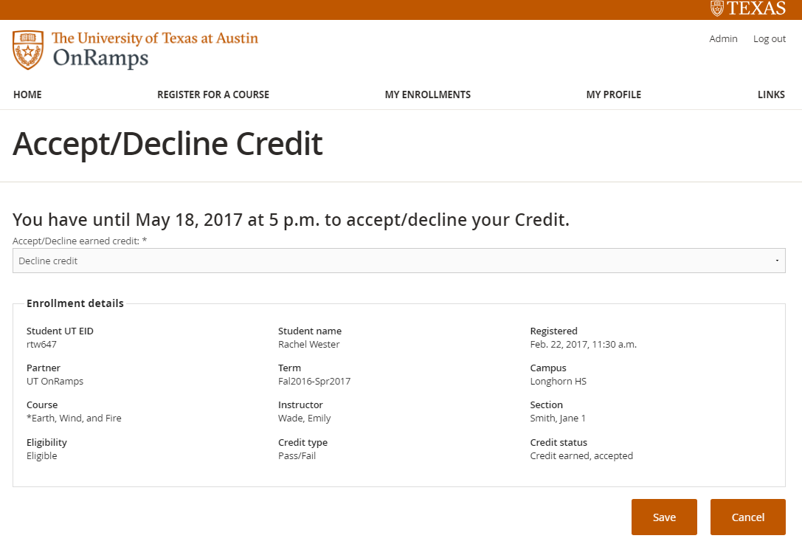
Step-by-Step Instructions
Students choose Accept credit or Decline credit from the drop-down menu and click Save.

Slide 7
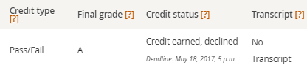

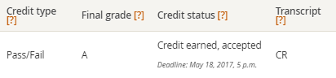
Step-by-Step Instructions
Students will be redirected to Current Enrollments table, where they can see their updated Credit Status and their Transcript grade or code, which indicates what will appear on students’ UT Austin transcript.
If students decline earned credit, “No Transcript” will appear in the Transcript column.
If students accept earned credit with Letter Grade credit type, the Final grade will appear in the Transcript column.
If students accept earned credit with Pass/Fail credit type, “CR” will appear in the Transcript column.

Slide 8
Ordering Transcripts
Students who earn and accept credit for an OnRamps course will be able to order a UT Austin transcript beginning June 1.
OnRamps students cannot use the online transcript request. They must complete the UT Transcript Order Form and submit it via fax, mail, or email.

Slide 9
Enrollment Certification or
Non-Attendance Verification
Students who do not earn college credit or decline college credit will not have an academic record with UT Austin, so they should not submit a transcript request.
Students who need to provide information about their OnRamps enrollment to another institution should contact onramps-tech-help@utlists.utexas.edu.

Slide 10

Questions?
Contact
onramps-tech-help@utlists.utexas.edu
or 512-232-6872

