Slide 1
RHE 309K
REGISTRATION
Spring 2017

Slide 2
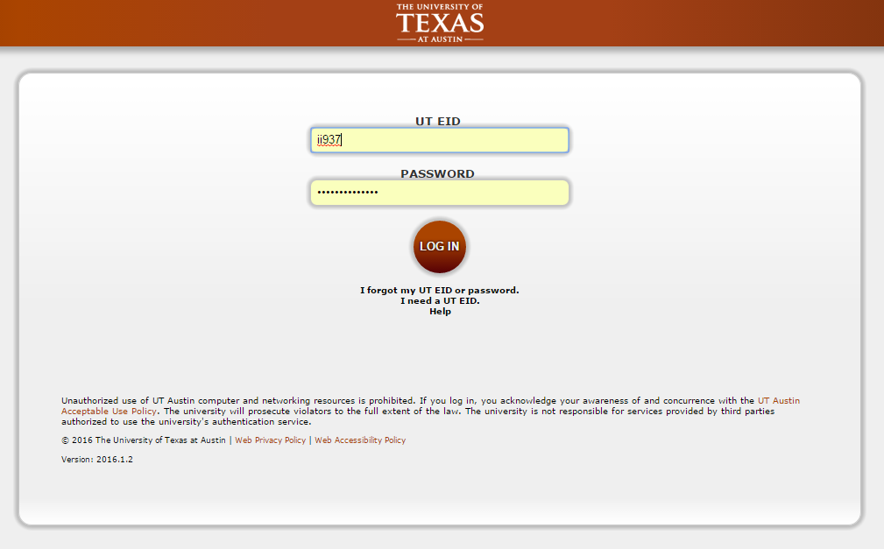
OnRamps Student Portal
Students use their EID and password to access the OnRamps Student Portal: https://utdirect.utexas.edu/apps/ce/osis/

Slide 3
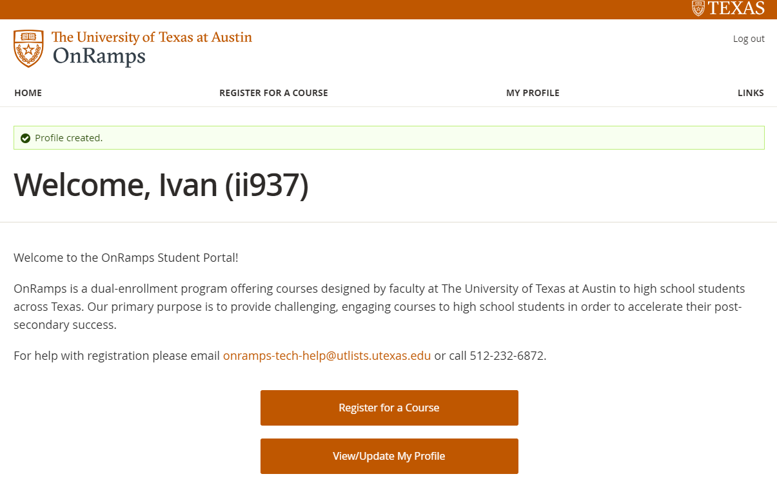
Registration
Students should click “Register for a Course” to register for their course.
Students will need to know their section number if there is more than one section of the course.

Slide 4
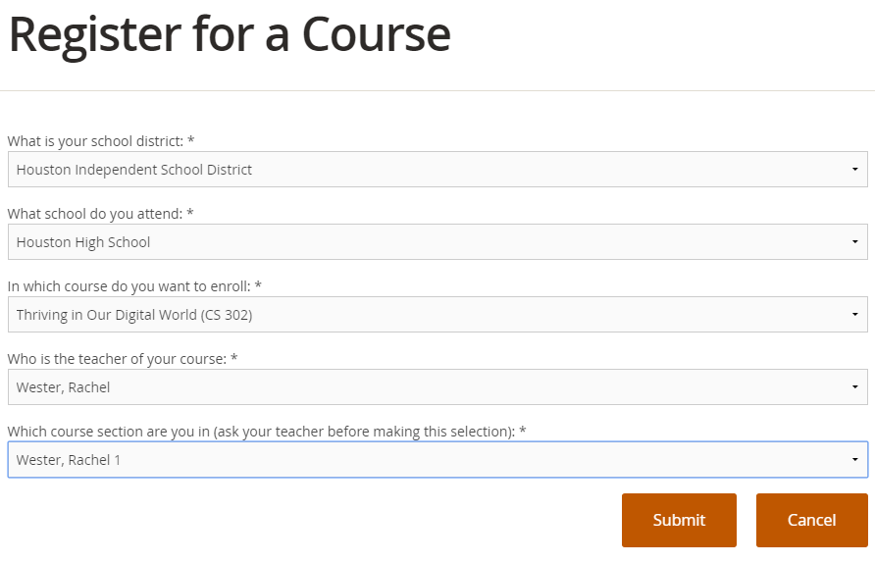
Registration
Student selects the appropriate District, Campus, Course, Instructor, and Section and clicks Submit.

Slide 5
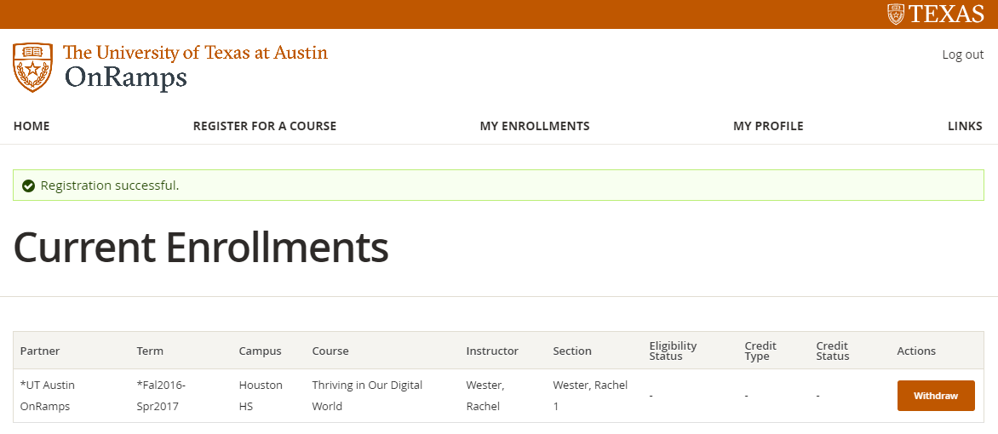
Registration
After clicking Submit, the student can review the enrollment on the Current Enrollments page.

Slide 6
Withdrawing from a Course
Students can withdraw from the course from the Current Enrollments page. They should click the Withdraw button next to the course.

Slide 7
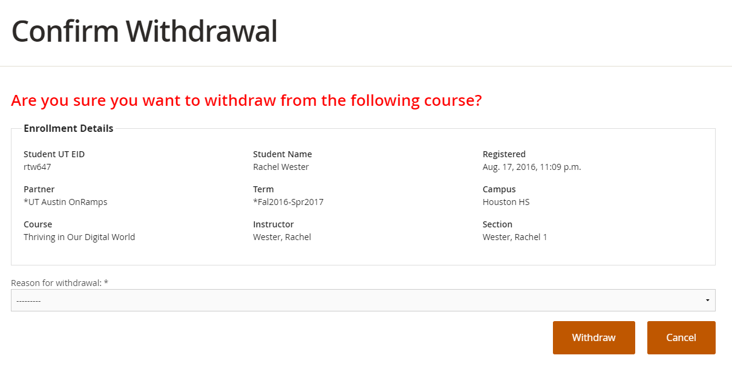
Withdrawing from a Course
Students will be directed to a withdrawal confirmation page, where they will select the reason for withdrawal and click Withdraw.

Slide 8
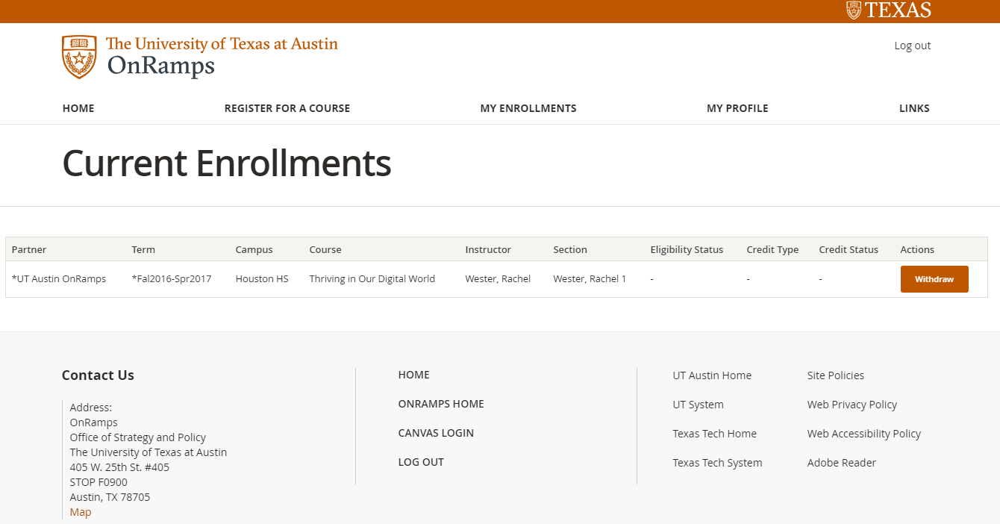
Accessing Courses in Canvas
Student clicks Canvas Login to access courses. The student will be automatically logged in to Canvas with their EID and password.

Slide 9
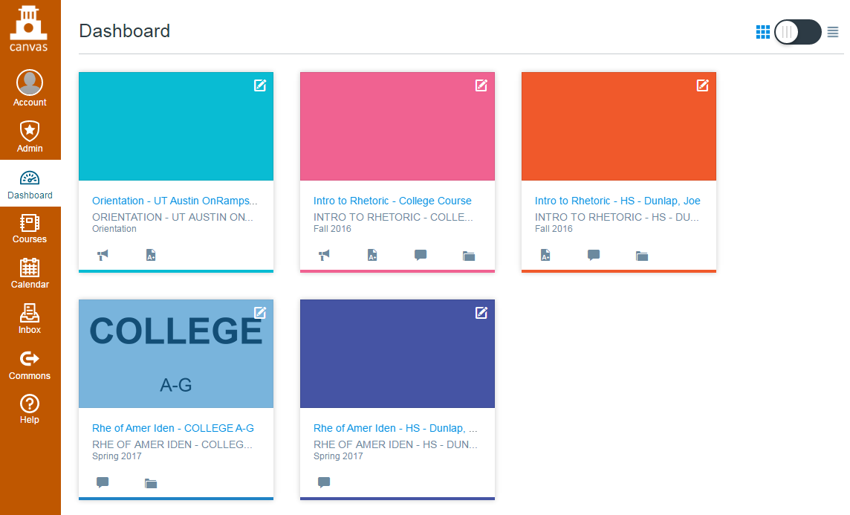
Accessing Courses in Canvas
Student’s new courses appear on the Canvas Dashboard.

Slide 10
Questions?
Contact onramps-tech-help@utlists.utexas.edu
or 512-232-6872

